Slide 1
HISAB KITAB
BOSTON INTERNATIONAL COLLEGE
A Minor Project II Report On
Presented by:
Subash Khatiwada
Samiksha Rana
Submitted To:
Department of BCIS

Slide 2
INTRODUCTION
Hisab Kitab is a mobile application designed to improve the way to manage the business & personal ledgers digitally.
After user login through their phone number they can create, update, and delete the transactions and send credit remainder to their customer.
Simplest UI, Can be used by non-technical persons
Features: CRUD Transaction, Credit Remainder
Automatic report generation and can save in pdf format

Slide 3
PROBLEM IN EXISTING SYSTEM
Traditional file system:
More chances for human error,
Hard to find past data,
Lengthy maintenance time,
High chance of data redundancy,
Expensive and hard to maintain.

Slide 4
OBJECTIVES
To provide secure transaction between users reducing the chances of error and easier to access past data.
To help small business owners manage their credit accounts and maintain their privacy.
To provide the data security & backup of the user so that they can get their data even if they lost their device.
To help the user get the balance, amount to be taken and amount to be paid at a glance setting the remainder

Slide 5
LITERATURE REVIEW
The things we found on our study:
Most of the business sectors still use traditional file system
Misconception of expensive technology
Lack of trust on foreign products for financial transaction
Most people are not able to use because of complex app structure
Most popular in foreign countries like India and USA

Slide 6
Hardware and Software Requirements
Hardware:
RAM: Recommended 4 GB or above
Processor: Intel i3 or above.
Hard-disk Storage: 2 GB or more
Software:
Operating System: Windows 7 or above
Front End tool: Flutter
Back End tool: SQLite

Slide 7
TOOLS AND TECHNOLOGY USED
Flutter (Dart)
Properties:
a. Free and open-source mobile UI framework
b. Reduced Code Development Time
c. Cross-platform- can use same code for Android and iOS
d. Custom, Animated UI of Any Complexity Available with large community

Slide 8
TOOLS AND TECHNOLOGY USED
SQLite
Its an open-source and completely free.
SQLite is server less
SQLite is a cross-platform DBMS
Storing data is easy

Slide 9
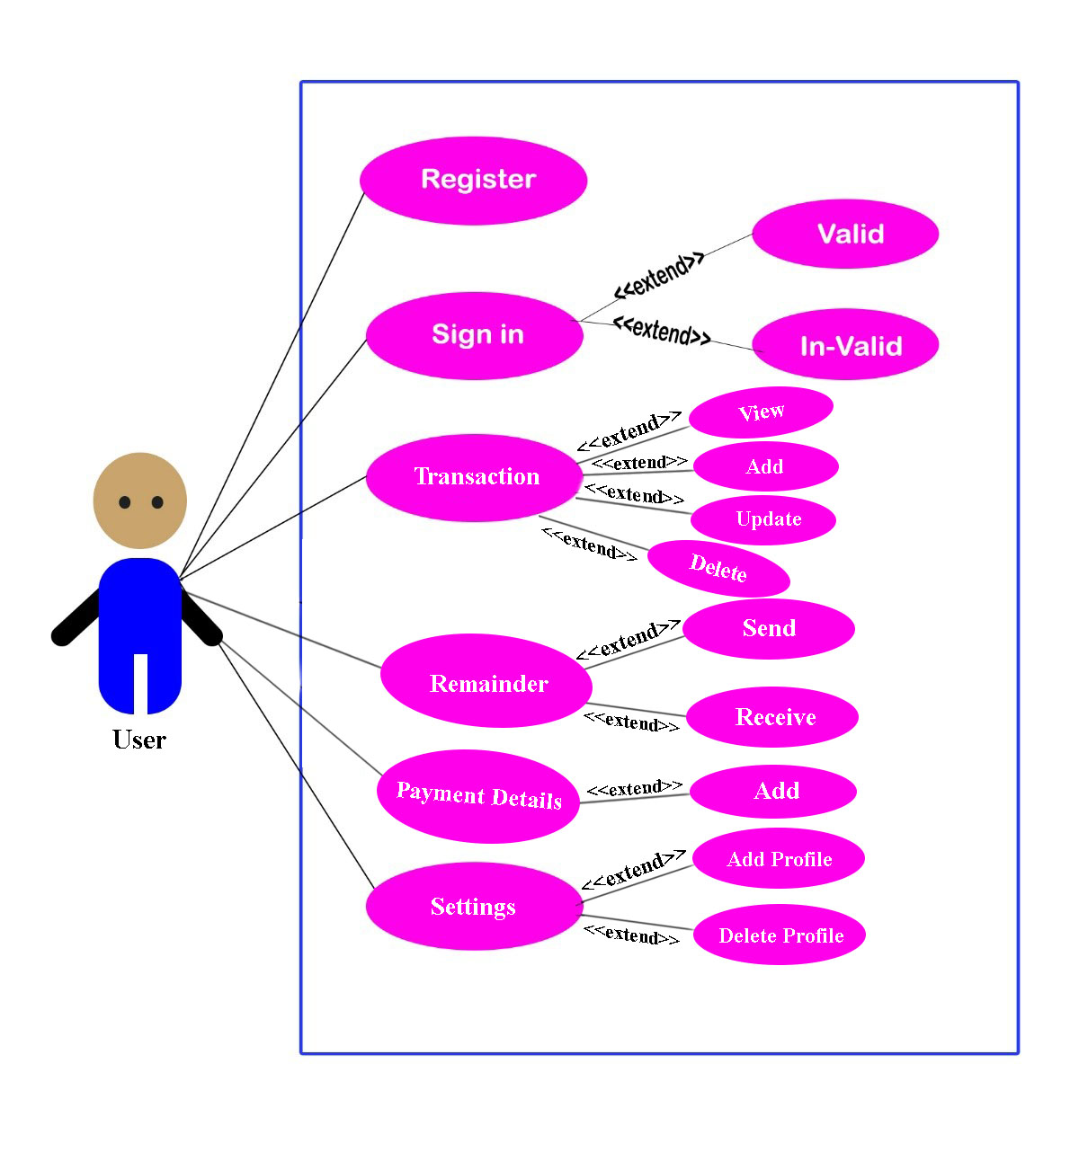
USE CASE DIAGRAM – HISAB KITAB

Slide 10
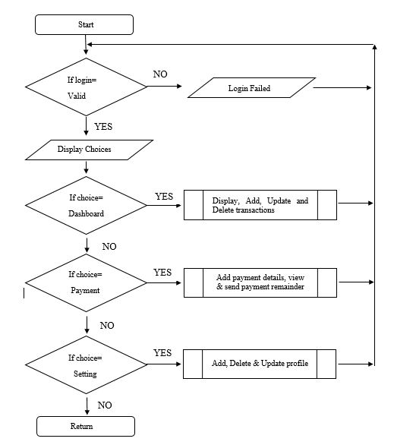
FLOW CHART

Slide 11
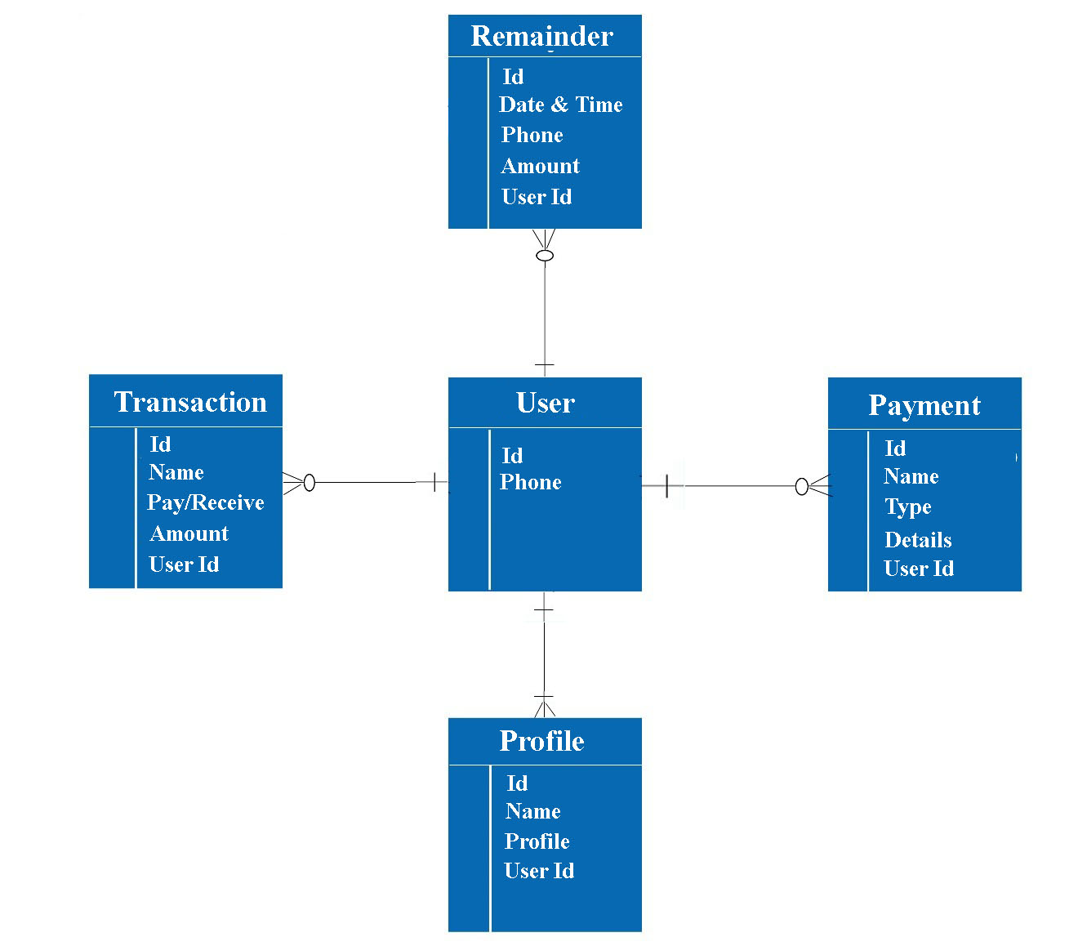
ER DIAGRAM – HISAB KITAB

Slide 12
DATABASE MANAGEMENT SYSTEM
5 tables in db: user, khata_profile, transaction, payment and remainder
Insert the data
Read the data
Update the data
Delete the data

Slide 13
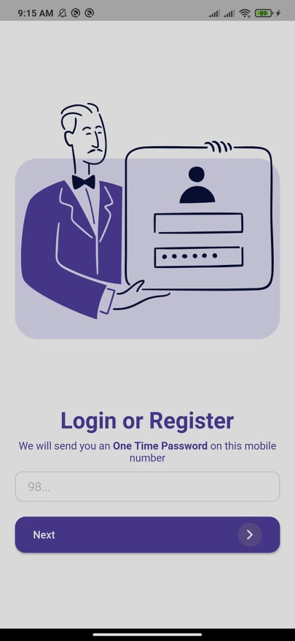
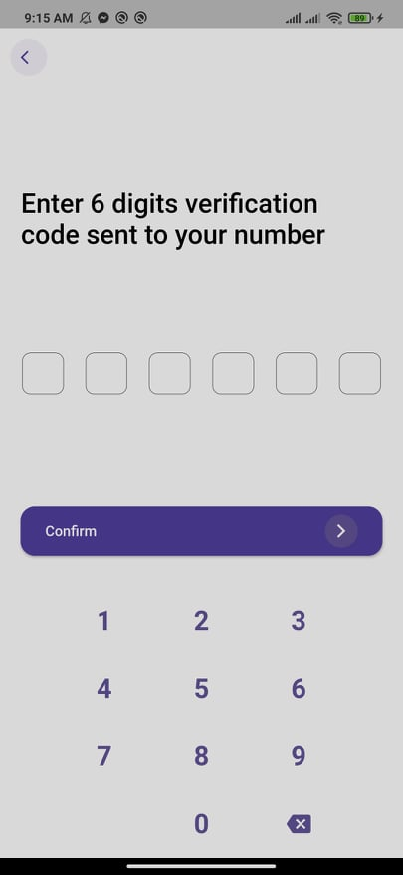
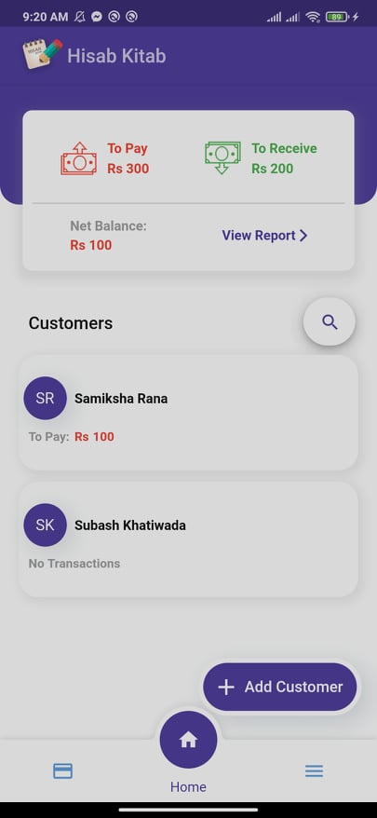
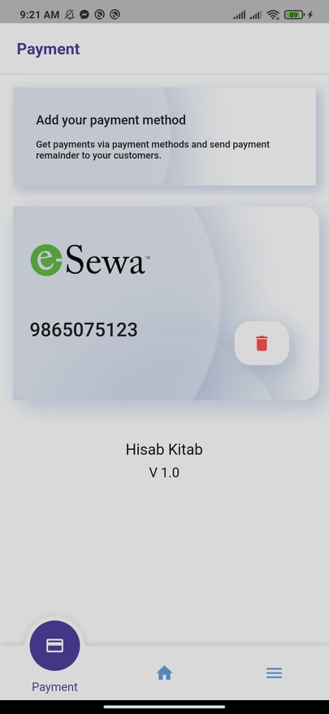
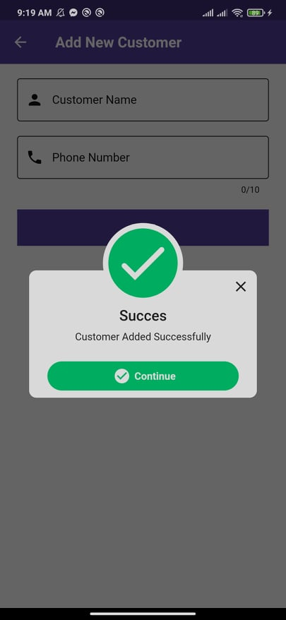
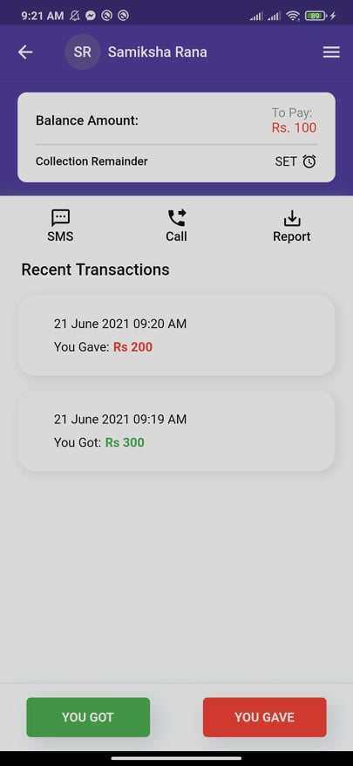
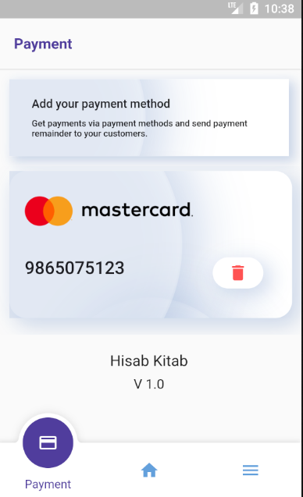
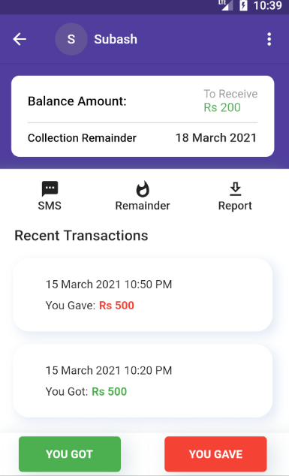
EXPECTED OUTPUT

Slide 14
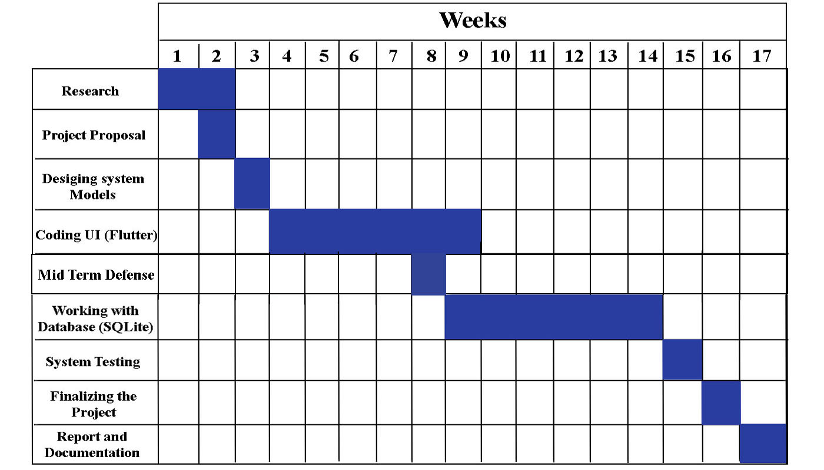
WORK SHEDULE

Slide 15
RESULT and DISCUSSION
The picture shown in the expected out is the result of our project.
Log-in method.
Represent the user’s registration and log- in process.
OPT verification.
OTP Verification verifies Email Address/Mobile Number of users by sending OTP verification code during registration and login. It removes the possibility of a user registering with fake Email Address/Mobile Number. The plug in also checks if Email Address/Mobile Number of a user already exists.
Home page
The homepage is the area that people notice at the first glance and decide their basic judgments about the application
Payment methods
It helps us to send payment remainder to the customers. For eg. Dear customer, you have Rs. 5000 payable amount. Please deposit it in our esewa account 9812345678. Thankyou !. This types of notification can be send to the customer.
Customer’s info method
we can add the customer with their resgistered number.
User’s profile.
It shows that how much money we need to pay or receive from the customer. Here we can add more number of customers records. It shows the balance records, and all financial records of users. In this , the records of receiving and paying amount of user are stored.
Total report page
It shows all of the records activities of a customer.

Slide 16
CONCLUSION
It is basically a credit management system which can access all the databases and picks up different function through the user interaction in the system.
Overcomes the many limitations of the existing similar system like traditional file keeping and user remainder for credits
Can change the way how business and individual manages their ledgers by using this digitalized system

Slide 17
FUTURE ENHANCEMENT
Can add expenses tracker and calculate profit and loss
Can add different tools like tax calculator, billing system and more
Will also work on data security, data integration and building more user friendly UI’s.

Slide 18


